Slide 1
Travel and tourism management System
CSE- 2112 : OOP Project
Made by:
Md. Mahmudur Rahman Moin (30)
Md. Sharif (14)
University of Dhaka

Slide 2
Aim
Reduce manual work for travel agencies by digitizing bookings, payments, and customer inquiries.
Enable customers to search for destinations, hotels, transport options, and tour packages effortlessly.
Offer a user-friendly interface with an intuitive booking process.
Store and manage travel-related information such as hotels, tourist spots, pricing, and user details in a structured database.
Ensure quick retrieval and updates of information.
Allow users to book hotels and tour packages through an integrated system.
Design the system to handle multiple users and large datasets efficiently.

Slide 3
Features
JDBS for storing and using multiple user and hotel information
Spectacular interfaces including colors and images
Splash window at intro
Storing phone number and email in Sign up menu
Password recovery system using phone number and email
Loading screen after logging in
Dashboard menu to access all the necessary functions
Log out button in dashboard
Add and update personal information
Deleting account
Checking available hotels, packages and tour destination
Booking hotels and packages
Utility application: Calculator

Slide 4
Diagram of the project
Splash
Log In menu
Sign Up
Forget Password
Log In
Dashboard

Slide 5
Diagram of the project
View Personal
Details
Check Packages
View Package
Add Personal
Details
Book Hotel
Dashboard
Destination
Update Personal
Details
About
Calculator
Delete Current Account
View Booked Hotel
Book Packages
View Hotels

Slide 6
Video Link
https://youtu.be/9hC3Vglsp28
For Source code:
https://github.com/Moin529/CSE-2112-OOP-Project/tree/main

Slide 7
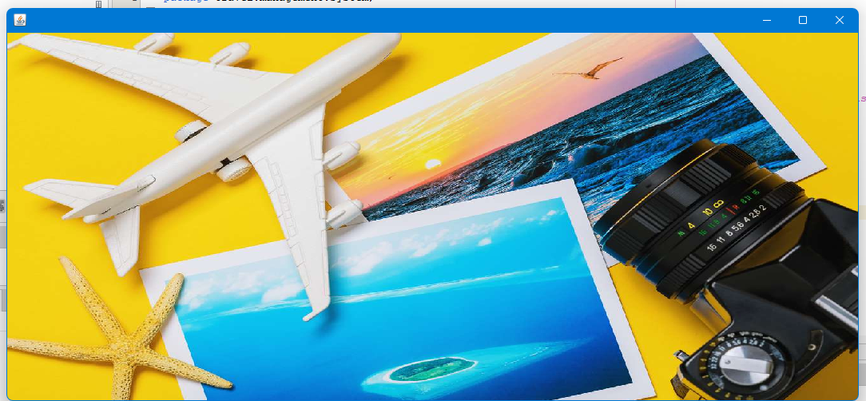
Splash
Intro window that zooms out end closes after a few seconds
Thread and loop is used to control the zoom out and Thread.sleep(5000) is used to keep the window visible for five seconds
Zoom out code:
public static void main(String[] args) {
Splash frame = new Splash();
int x = 1;
for(int i=1; i<=500; x+=7, i+=6){
frame.setLocation(780 - (x+i)/2, 400 - (i/2));
frame.setSize(x + i, i);
try{
Thread.sleep(10);
}catch(Exception e){
e.printStackTrace();
}
}
}
Added image using ImageIcon and set it to a label

Slide 8
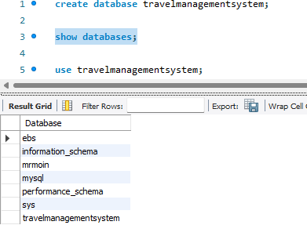
Connection to MySQL
In a different Conn class we make objects of Connection(c) and Statement(s)
We put the code for connecting to database in try-catch:
Class.forName("com.mysql.cj.jdbc.Driver");
c = DriverManager.getConnection("jdbc:mysql://localhost:3306/travelmanagementsystem", "root", “<your password>");
s = c.createStatement();

Slide 9
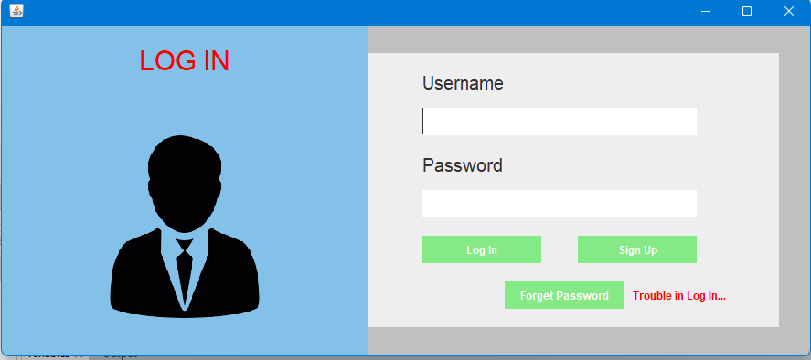
Log In Menu
Labels : LOG IN, Username, Password, Trouble in Log In
Buttons : Log In, Sign Up, Forget Password
Text Fields : tfusername, tfpassword
Setting the size of window:
setSize(900, 400);
setLocation(350, 220);
or,
setBounds(350, 220, 900, 400);
Two panels : p1(blue), p2(white)
If credentials matches data from database user can log in

Slide 10
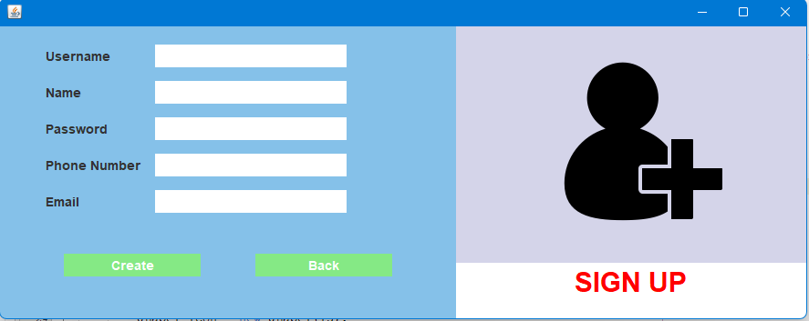
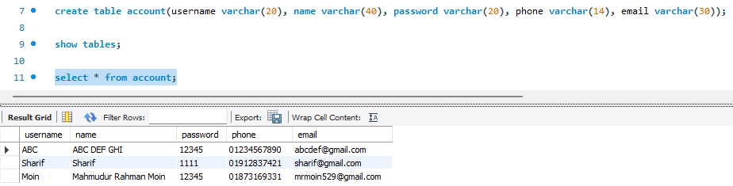
Sign Up
String query = "insert into account values ('"+username+"', '"+name+"', '"+password+"', '"+phone+"', '"+email+"')";

Slide 11
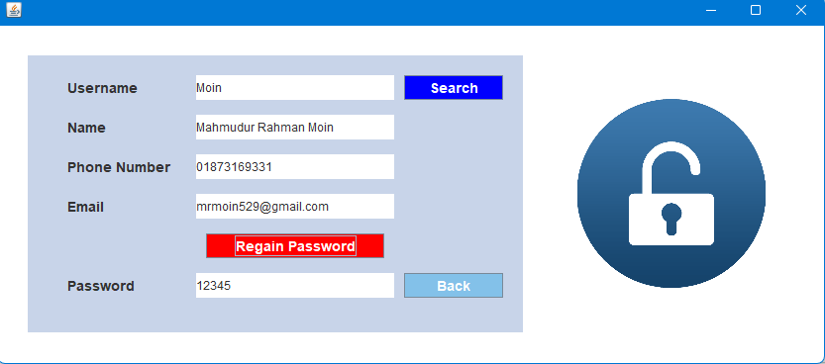
Forget Password
First searches by the username
If username matches from sql database, it prints full name
Phone number and email, which is used to sign up, must be remembered to regain password

Slide 12
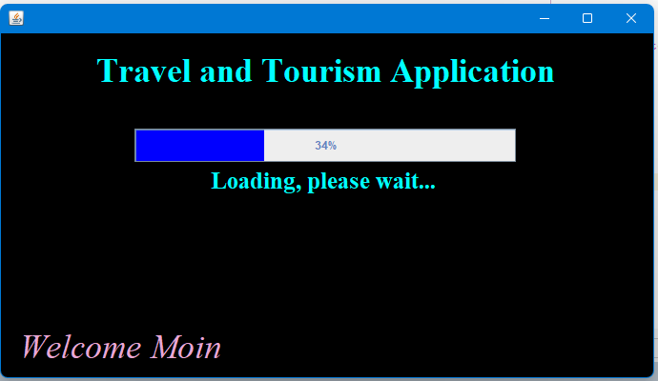
Loading Screen
Thread and JProgressBar are used to handle the loading bar
In run method:
for(int i=1; i<=101; i++){
int max = bar.getMaximum();
int value = bar.getValue();
if(value < max){
bar.setValue(bar.getValue() + 1);
}
else{
setVisible(false);
new Dashboard(username);
}
Thread.sleep(50);
}

Slide 13
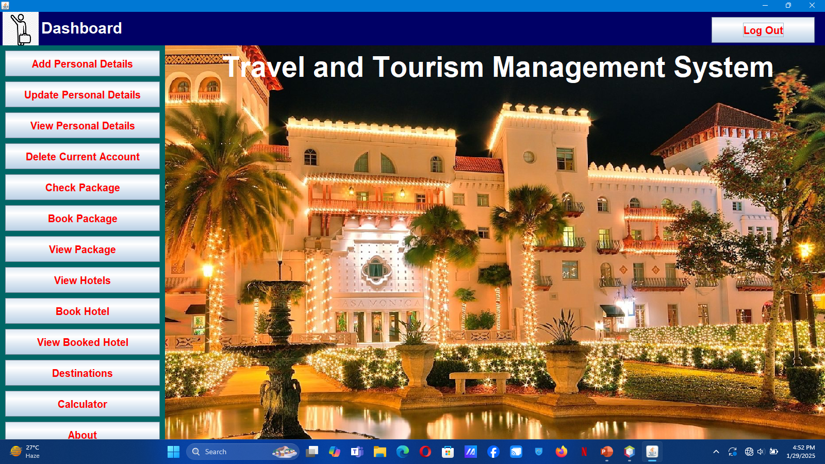
Dashboard

Slide 14
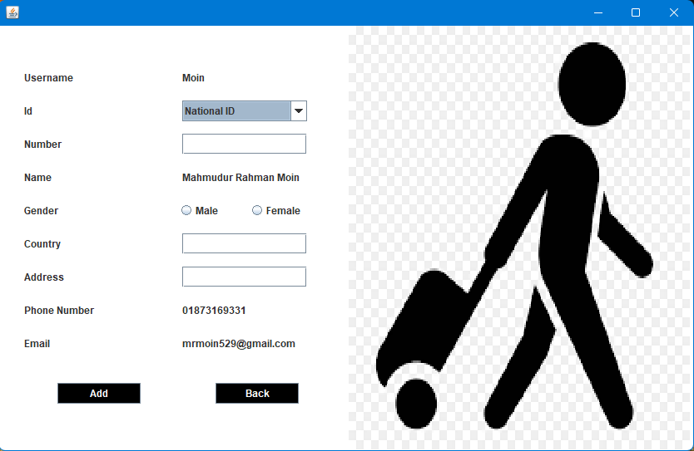
Add Personal Details
Adding further informations (ID, ID number, Gender, Country, Address) with sign up details
JComboBox used for drop down box
JRadioButton used for gender and ensuring only one button is selected at a time:
ButtonGroup bg = new ButtonGroup();
// For selecting only one of the genders
bg.add(rmale);
bg.add(rfemale);
Informations are stored in customer table of mysql

Slide 15
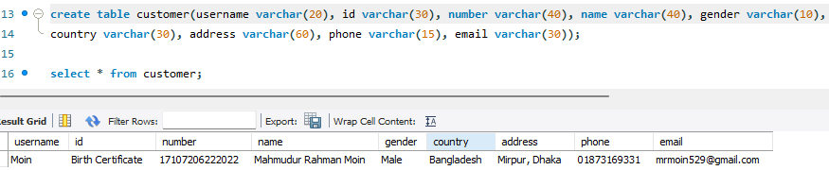
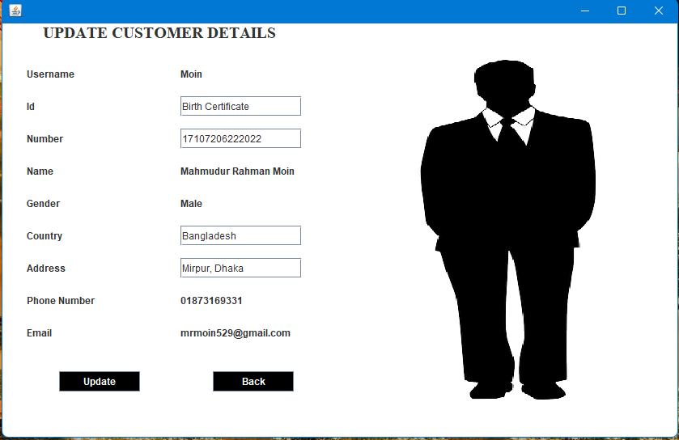
Update Personal Details
Conn c = new Conn();
String query = "update customer set username = '"+username+"', id = '"+id+"', number = '"+number+"', name = '"+name+"', gender = '"+gender+"', country = '"+country+"', address = '"+address+"', phone = '"+phone+"', email = '"+email+“’”;
c.s.executeUpdate(query);

Slide 16
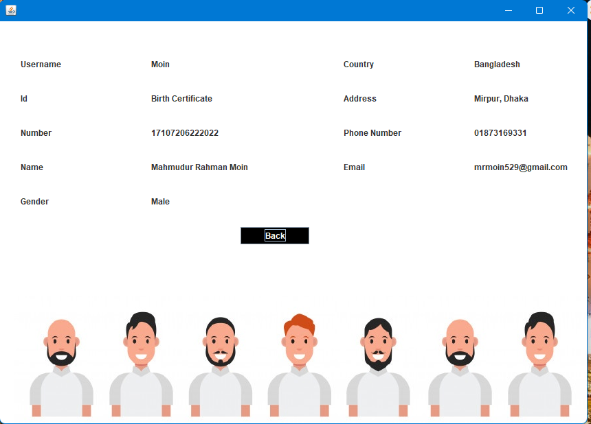
View Personal Details
String query = "select * from customer where username = '"+username+"'";
ResultSet res = conn.s.executeQuery(query);
while(res.next()){
labelusername.setText(res.getString("username"));
labelid.setText(res.getString("id"));
labelnumber.setText(res.getString("number"));
.
.
.
}

Slide 17
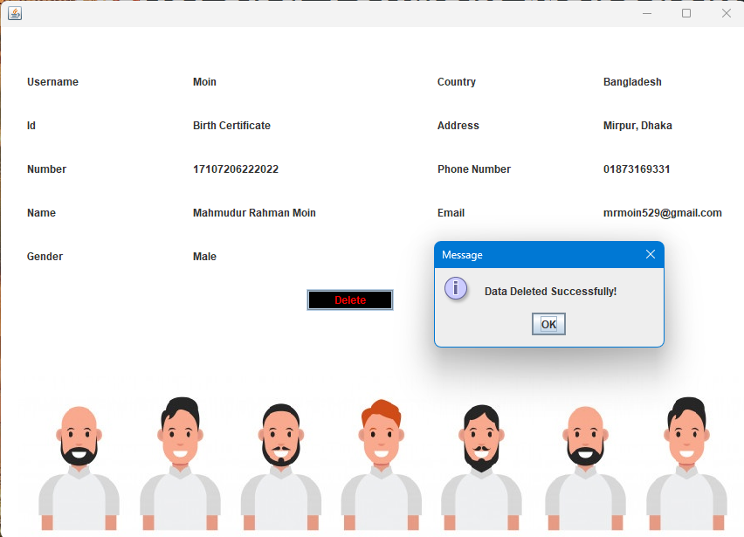
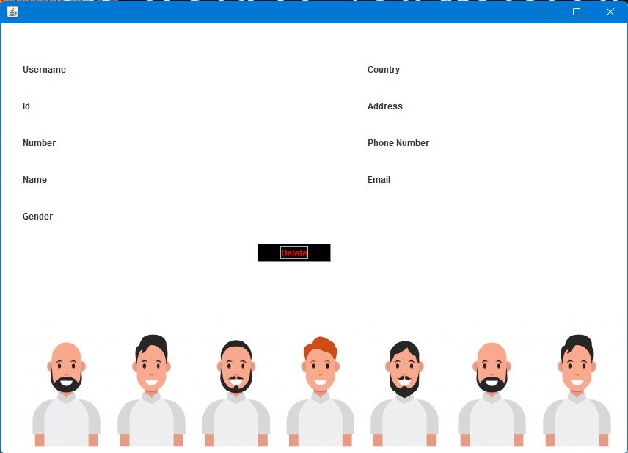
Delete Account
c.s.executeUpdate("delete from account where username = '"+username+"'");
c.s.executeUpdate("delete from customer where username = '"+username+"'");

Slide 18
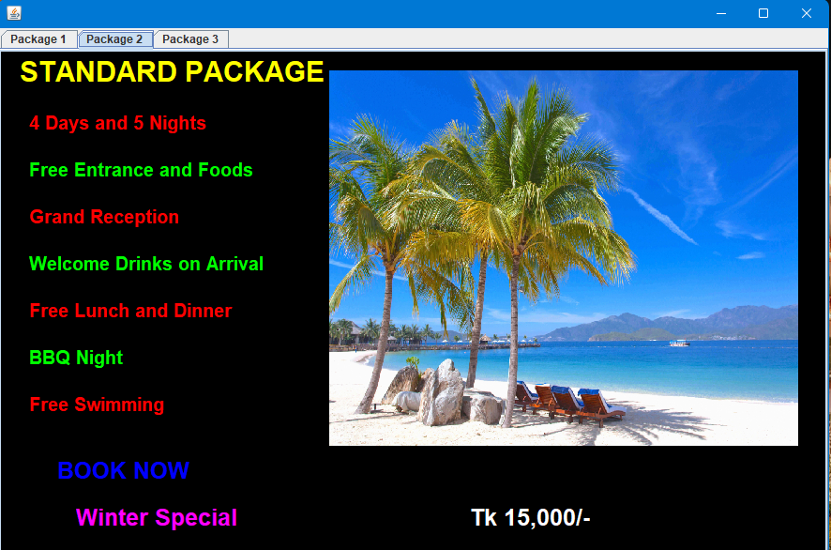
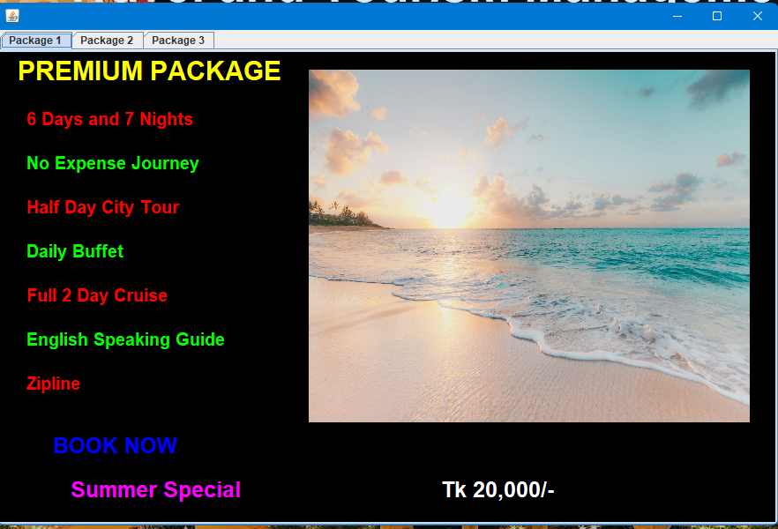
Check Package
//For tab
JTabbedPane tab = new JTabbedPane();
JPanel p1 = createPackage(package1);
tab.addTab("Package 1", null, p1);
JPanel p2 = createPackage(package2);
tab.addTab("Package 2", null, p2);
JPanel p3 = createPackage(package3);
tab.addTab("Package 3", null, p3);
add(tab);

Slide 19
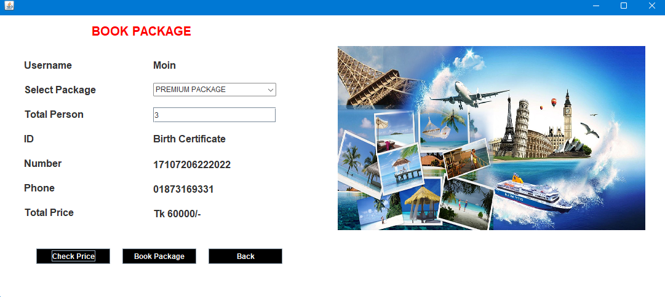
Book Package
Insert values of package, total persons and price in bookpackage table in mysql
Package price set by if-else condition for drop down box:
Premium package = Tk 20000/- per person
Standard package = Tk 15000/- per person
Basic package = Tk 12000/- per person

Slide 20
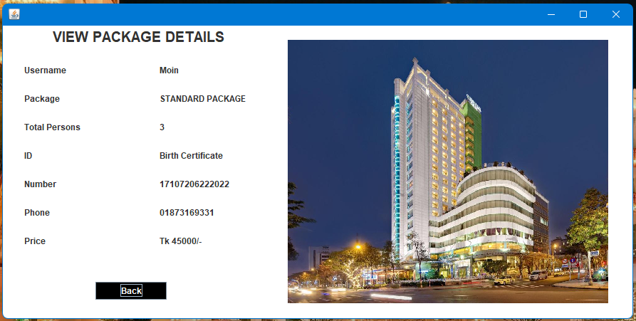
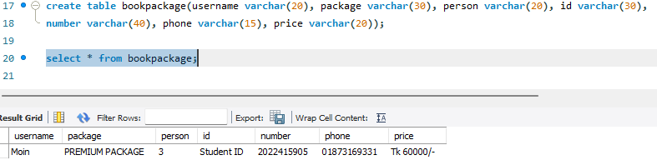
View Package
Similar functionality to view personal details class

Slide 21
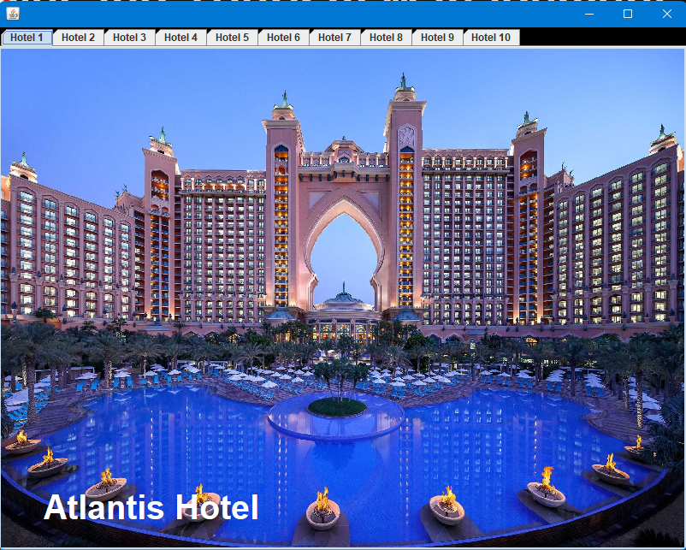
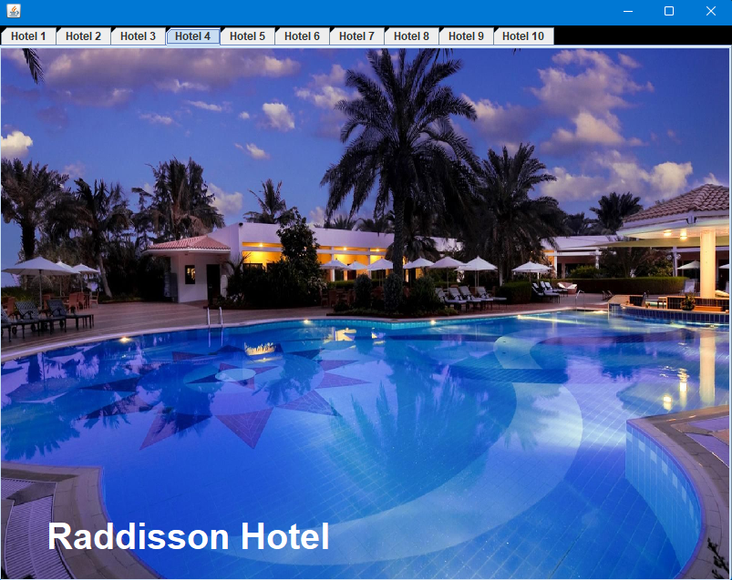
View Hotels
JTabbedPane is used
String[] hotel1 = {"Atlantis Hotel", "hotel1.jpg"};
String[] hotel2 = {"Sea Pearl Hotel", "hotel2.jpg"};
…
Functionality is similar to check package

Slide 22
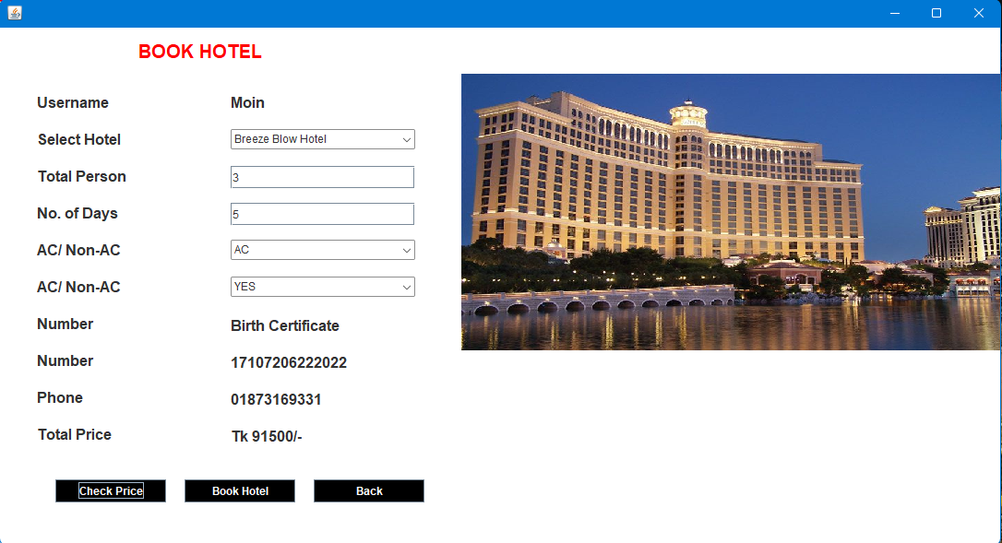
Book Hotel
Prices are inserted in hotel table in mysql
Choice keyword is used to make object of the dropdown boxes
If-else conditions and arithmetic operations used for calculating prices for selected hotel with preferred facilities(AC and Food)
If book hotel button is clicked, then information are stored in bookhotel table in mysql

Slide 23
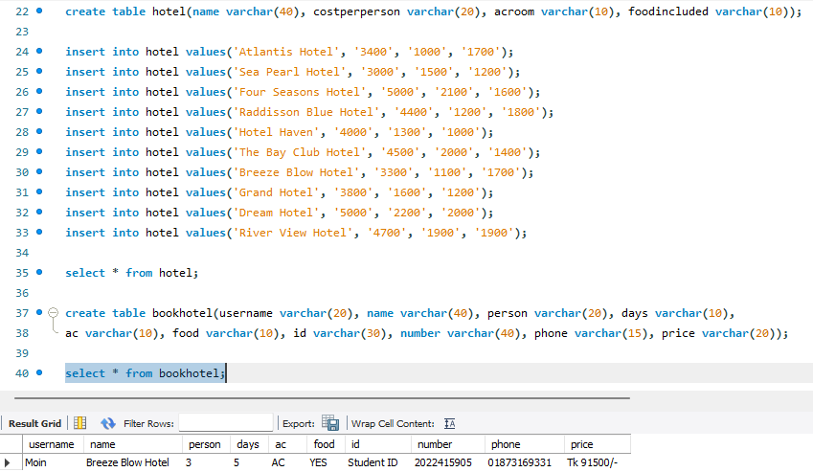
Book Hotel

Slide 24
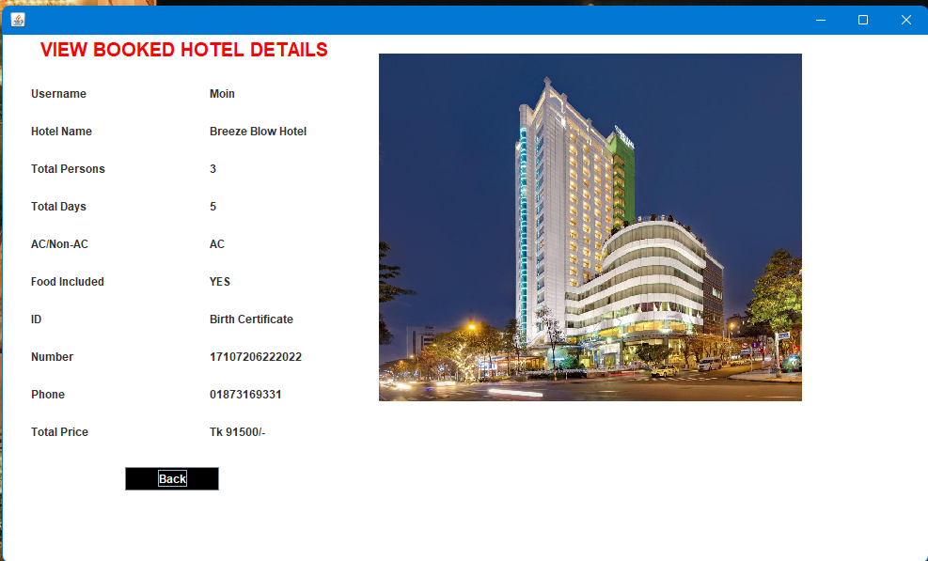
View Booked Hotel
Functionality is similar to view personal details class

Slide 25
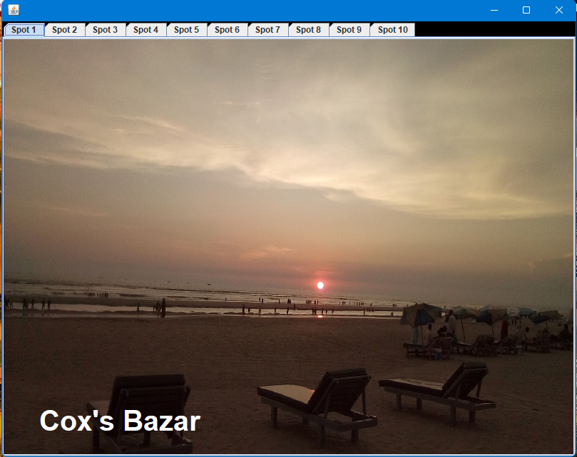
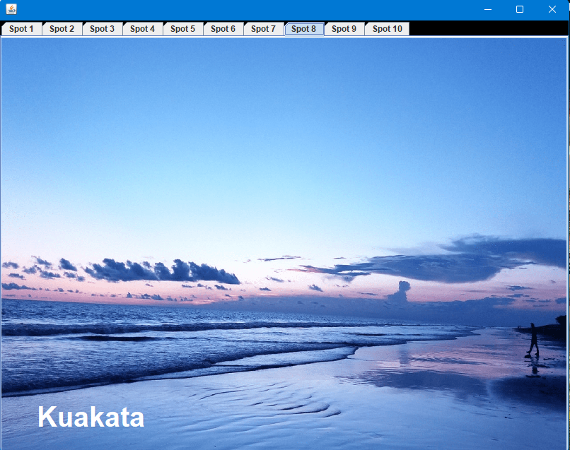
Destinations
Similar functionalities and attributes to Check Packages are used
JTabbedPane used for multiple tab
String are similarly handled like before in View Hotel

Slide 26
Calculator
Utility application
If button is clicked this code will run and execute the calculator:
try{
Runtime.getRuntime().exec("calc.exe");
}catch(Exception e){
e.printStackTrace();
}

Slide 27
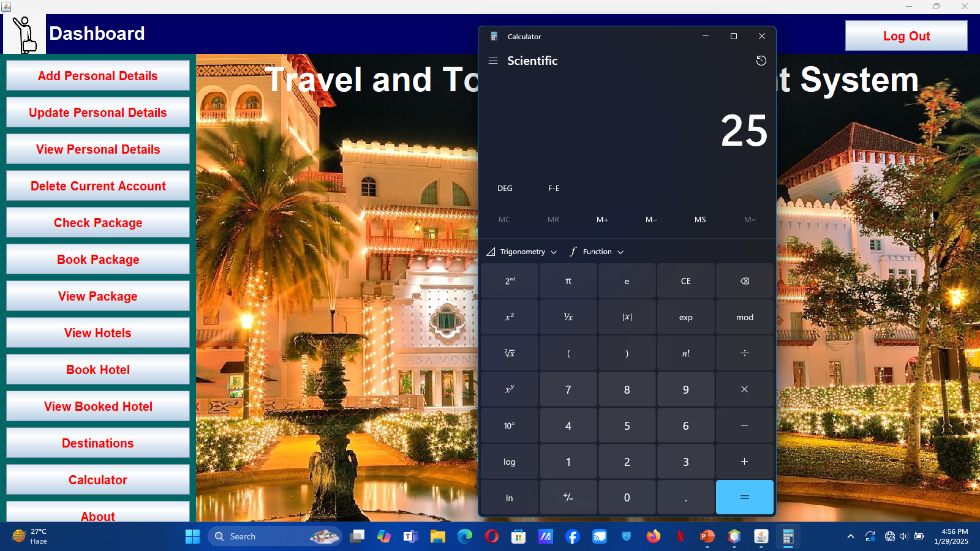
Calculator

Slide 28
Future Enhancement
Adding a payment method for paying booked prices
More enhanced Graphical interfaces with less effort
Spots from abroad will be available soon
After introduction of abroad tourism flight price will be added to the packages
More developed security system in securing personal information of the users
Easier ways to password recovery and log in

Slide 29
Contributions
Md. Mahmudur Rahman Moin-30:
Database integration using MySQL
Development of Dashboard UI
Managing user’s personal details
Account deletion system
Package details using multiple tab
Package booking system
Destination tabs
Utility app : Calculator
Md. Sharif-14:
Splash intro
Login and Signup mechanism
Password recovery system
Loading screen system
Checking hotel details using multiple tab
Hotel booking system

Slide 30
Tools
Programming Language: Java
GUI Design tool: Java Swing
Database: MySQL JDBS
IDE: Apache NetBeans IDE 24
OS: Windows 10 / 11

Slide 31
Reference
https://www.w3schools.com
https://www.javatpoint.com
https://www.codecademy.com
https://www.stackoverflow.com
https://youtu.be/5vzCjvUwMXg

Slide 32
Thank You

